Slide 1
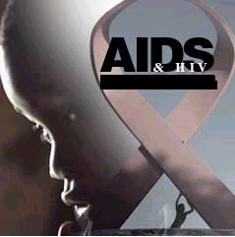

Voluntary Health Association of Meghalaya

Slide 2
The immune system is considered deficient when it can no longer fulfill its role of fighting off infections and diseases.
Immuno-deficient people are more susceptible to a wide range of infections, most of which are rare among people without immune deficiency.
Infections associated with severe immunodeficiency are known as 'opportunistic infections', because they take advantage of a weakened immune system.

Slide 3
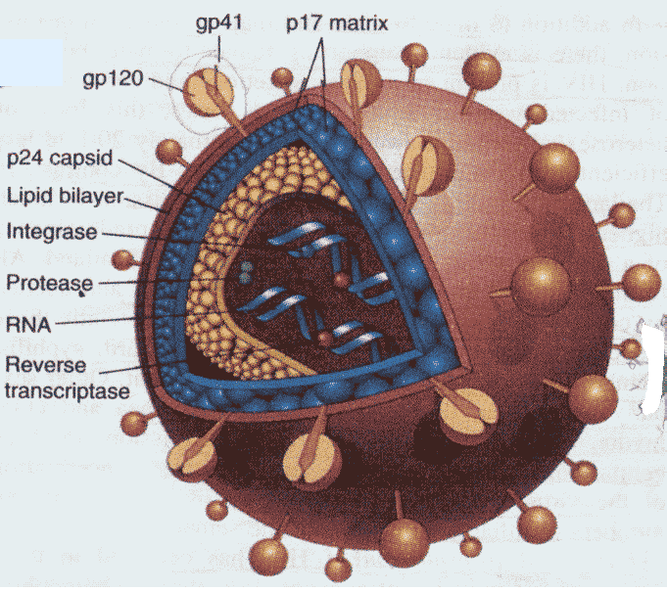
WHAT IS HIV / AIDS ?
H Human
I Immunodeficiency
V Virus
A Acquired
I Immune
D Deficiency
S Syndrome
It destroys the immune system of the body which is essential for warding off infections.

Slide 4
What causes AIDS?
A virus known as Human Immunodeficiency Virus (HIV) causes AIDS
HIV attacks the body’s immune system and weakens it over time. It causes AIDS by destroying the body's ability to fight various diseases.
A person who has HIV gradually loses the protection of his or her immune system and begins to experience health problems.
People can live with HIV-infection for many years without developing AIDS

Slide 5
AIDS
Acquired: something that is obtained or received by a person, which does not ordinarily exist within one’s body
Immune: Refers to the immune system (the system that fights out infections and also helps keeping cancerous growth at bay)
Deficiency: The immune system is weakened or damaged
Syndrome: AIDS is not one particular isolated disease but has a variety of symptoms (syndromes) leading to various disorders and set of diseases

Slide 6
What are the symptoms of HIV?
Most people infected with HIV do not know that they have become infected, because they do not feel ill immediately after infection.

Slide 7
After exposure to a source of infection a person may remain asymptomatic for a period of 5 – 10 years on an average although HIV positive.
An individual may not test positive for a period of 2 to 3 months (up to 11 months ) in spite of being positive-Window Period
Transmission has occurred but there is no antibody production.

Slide 8
Whether or not HIV infection causes initial symptoms, an HIV-infected person is highly
infectious during this initial period and can transmit the virus to another person.
The only way to determine whether HIV is present in a person's body is by testing for HIV antibodies or for HIV itself.
The term AIDS applies to the most advanced stages of HIV infection, defined by the occurrence of any of more than 20 opportunistic infections or HIV-related cancers.

Slide 9

What is a HIV test?
A HIV test is a test that reveals whether HIV is present in the body. Commonly-used HIV tests detect the antibodies produced by the immune system in response to HIV, as it is much easier (and cheaper) to detect antibodies than the virus itself.
Antibodies are produced by the immune system in response to an infection.

Slide 10
How is HIV transmitted?
HIV is found in many body fluids including blood, semen, vaginal fluids and breast milk
HIV is transmitted through:
􀂃 Unprotected penetrative (vaginal or anal) and oral sex with an infected person 80%
􀂃 Blood transfusion with contaminated blood
􀂃 By using contaminated syringes, needles or other sharp instruments
􀂃 From an infected mother to her child during pregnancy, childbirth and
breastfeeding

Slide 11
Factors related to sexual transmission
Viral load of the HIV-positive partner
Presence of genital infection
Type of sexual activity
Risk of sexual activity causing bleeding
or tearing
Presence of blood
Other factors
C1.17 Source: The HIV/AIDS Resource Manual: A resource for HIV/AIDS educators. Sydney, AFAO (Australian Federation of AIDS Organisations), 1998.
Notes:
Teaching Notes
Show slide C1.17
Next ask: How is HIV transmitted via blood contact?
The answer should be similar to:
Blood contact between an HIV-positive and an HIV-negative person is one of the most efficient means of transmitting HIV. The immediate re-use of a needle and syringe after they have been used by an HIV-positive person is an extremely high-risk behaviour for the transmission of HIV: the sharing of other injecting materials such as the water with which a drug is mixed, spoon or other device to heat drugs in, and the filter (often a ball of cotton wool) used to filter the drug can also lead to HIV transmission. Infected blood and blood products used in medical procedures can spread HIV very widely. Some infections have also occurred via contact with invasive equipment used in surgeries, such as dental equipment.

Slide 12
Factors related to blood contact
Re-use of a needle and syringe
Sharing of other injecting materials,
e.g. water, spoon, filter
Infected blood and blood products
Surgical equipment
C1.18 Source: The HIV/AIDS Resource Manual: A resource for HIV/AIDS educators. Sydney, AFAO (Australian Federation of AIDS Organisations), 1998.
Notes:
Teaching Notes
Show slide C1.18
Next ask: How is HIV transmitted from mother to child?
The answer should be similar to:
Studies have found that, without appropriate HIV treatment (with medications such as AZT or nevirapine), between 8% and 45% of babies born to HIV-positive women acquire the infection. Factors that affect the likelihood of mother-to-infant transmission include:
the concentration of virus present in the bloodstream of the mother (her viral load);
the stage of her HIV illness;
breastfeeding, which has been shown to be a strong risk factor, both in studies of women who became HIV positive after giving birth and in studies of women HIV positive at the time of delivery; and
vaginal delivery, which, when compared with uncomplicated Caesarian section, slightly increases the risk of infection.

Slide 13
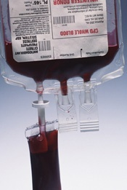
Transfusion of unscreened, infected blood or accidental exposure to infected blood, blood products or body fluids in health care settings
A needle prick may have a 0.05 % chance of transfer

Slide 14
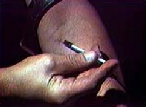
Sharing infected syringes and needles:
Transfer of HIV infected blood from one person to another would directly transmit HIV. The chances of passing on the HIV in such a situation is about 90%.

Slide 15
Factors related to mother-to-child transmission
Viral load of HIV-positive mother
Stage of her HIV illness
Breastfeeding
Vaginal delivery (compared with elective caesarean section)
C1.19 Source: The HIV/AIDS Resource Manual: A resource for HIV/AIDS educators. Sydney, AFAO (Australian Federation of AIDS Organisations), 1998.
Notes:
Teaching Notes
Show slide C1.19
Next ask: Can HIV be transmitted through the air?
The answer should be:
NO. HIV is a relatively fragile virus, quickly destroyed outside the body and outside needles and syringes or other containers. The exact time will depend on factors such as temperature or moisture, but has been estimated at 20 minutes or much less (though the time can be much longer when HIV is inside a container such as a syringe). HIV is also destroyed if it comes into contact with some chemicals (such as bleach) and other agents.
Next ask: Can HIV be transmitted by mosquitoes?
The answer should be:
NO. HIV is not transmitted by mosquitoes, bed bugs, or other insects. Evidence for a lack of transmission via these insects comes from two areas. Unlike, for instance, malaria, HIV does not replicate inside these insects. If an insect is carrying live HIV, it is because it has recently bitten a person with HIV Although the insect may carry HIV, it is unable to transmit it. This is because of the extremely minute amounts of blood that could exist on the mouthparts of these insects. In addition, insects do not inject blood—either their own or anyone else’s — into individuals; they inject saliva, which works as a lubricant and anti-coagulant. This saliva does not contain HIV.
Next ask: Can HIV be transmitted by household or casual contact?
The answer should be:
NO. Studies of the household and casual contacts of people with HIV infection have not revealed any risk of HIV transmission. There is no risk of acquiring HIV through the use or sharing of common communal and household objects such as toilet seats, shower facilities, cutlery, glassware or food. There is no risk of contracting HIV through swimming pools.

Slide 16
HIV can be prevented...
Use Condoms when having sexual intercourse.
Do not share injecting equipment
HIV treatment for HIV+ mothers,
Screening blood and blood products for HIV during blood transfusion
C1.21 Source: The HIV/AIDS Resource Manual: A resource for HIV/AIDS educators. Sydney, AFAO (Australian Federation of AIDS Organisations), 1998.
Notes:
Teaching Notes
Show slide C1.21
Session C.1.6. Anonymous questions
Provide one 15 x 20cm card to each participant. Ask them to think about everything they have ever heard or read about HIV/AIDS, not only today but in previous months and years. Ask them to think about any question they have ever wanted to ask on this topic. Inform them that this session is called “Anonymous questions” and will attempt to answer any questions participants have: the questions are written anonymously in private and will be answered for all to hear. Ask participants to shield their card in some way (some may want to move to another part of the room for increased privacy), to write very clearly any question they have, make sure they do NOT put their name on the card and bring the card face down to the trainer. Inform them they have about seven minutes to think of questions and they can ask as many questions as they like.
Once the cards have been collected, the trainer (or guest lecturer) turns away from the group and shuffles the card back and forth (to ensure participants cannot read the cards while they are being shuffled). Cards should then be placed face down and the trainer or guest lecturer should pick up each card, read the question and provide an answer. Trainers or lecturers should try to keep answers brief and trainers should consider whether some questions will be answered in later sessions of the training course. Some questions will be sensitive or embarrassing and will lead to laughter but each question should be answered honestly and carefully.
Break
Normally a break would be held at about this point for coffee or tea, and to allow participants to move around and meet one another. It is common practice for such a break to last around 15-20 minutes.

Slide 17
Why should I get a HIV test?
Firstly, if you are HIV positive, you can take necessary steps before symptoms appear to access treatment, care and support services, thereby potentially prolonging your life for many years.
Secondly, if you know you are infected, you can take all the necessary precautions to
prevent the spread of HIV to others.
Thirdly, your health care provider may recommend it, for example if you are pregnant and want to protect your unborn child.
It may also be recommended by your health care provider if you are unwell, in order to obtain a more accurate medical assessment

Slide 18
Where DO I GET TESTED
At ICTC ,CIVIL HOSPITALS
ICTC, NEIGRIHMS,etc
Types of test:
ELISA
RAPID

Slide 19
Treatment for HIV/AIDS
AIDS is not curable.
There is no vaccine to prevent HIV
Treatment to prolong the life of the infected is available.
The treatment is free in ART centre placed at Civil Hospitals.

Slide 21


AIDS DOES NOT SPREAD BY
Daily social interaction, staying together, in schools/workplaces
Eating together/
Sharing cups, plates
Swimming in
A community pool

Slide 22
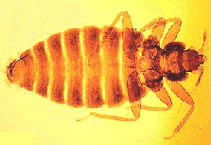



AIDS DOES NOT SPREAD BY
Use of public toilets and bathrooms
Coughing or Sneezing
Shaking hands or hugging
Mosquito, bug bites

Slide 23
For more information & any assistance
Voluntary Health Association of Meghalaya
Umkdait, Nongmensong, Shillong 793019
Email: vhamegh@gmail.com
Ph: 96152 05539

